Slide 1
HOW TO CLONE A DISK DRIVE USING MACRIUM REFLECT
BY AYEBARE ETHAN VU-BCS-2209-0878-DAY

Slide 2
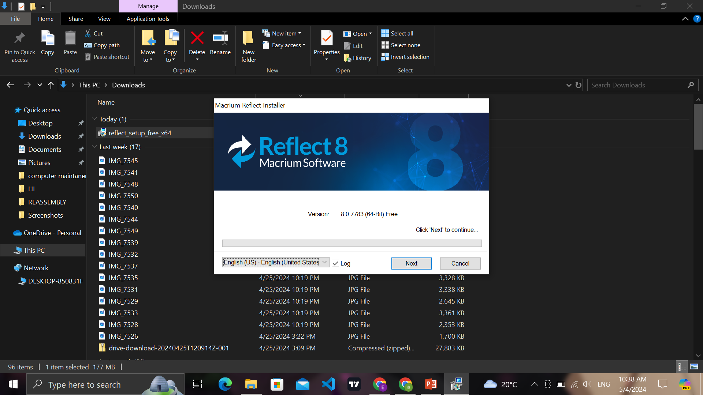
INSTALLATION
Download and Install Macrium Reflect: Visit the official website and download the appropriate version of Macrium Reflect for your system. Follow the installation instructions.
Launch Macrium Reflect: Once installed, open the application to access its main interface.

Slide 3
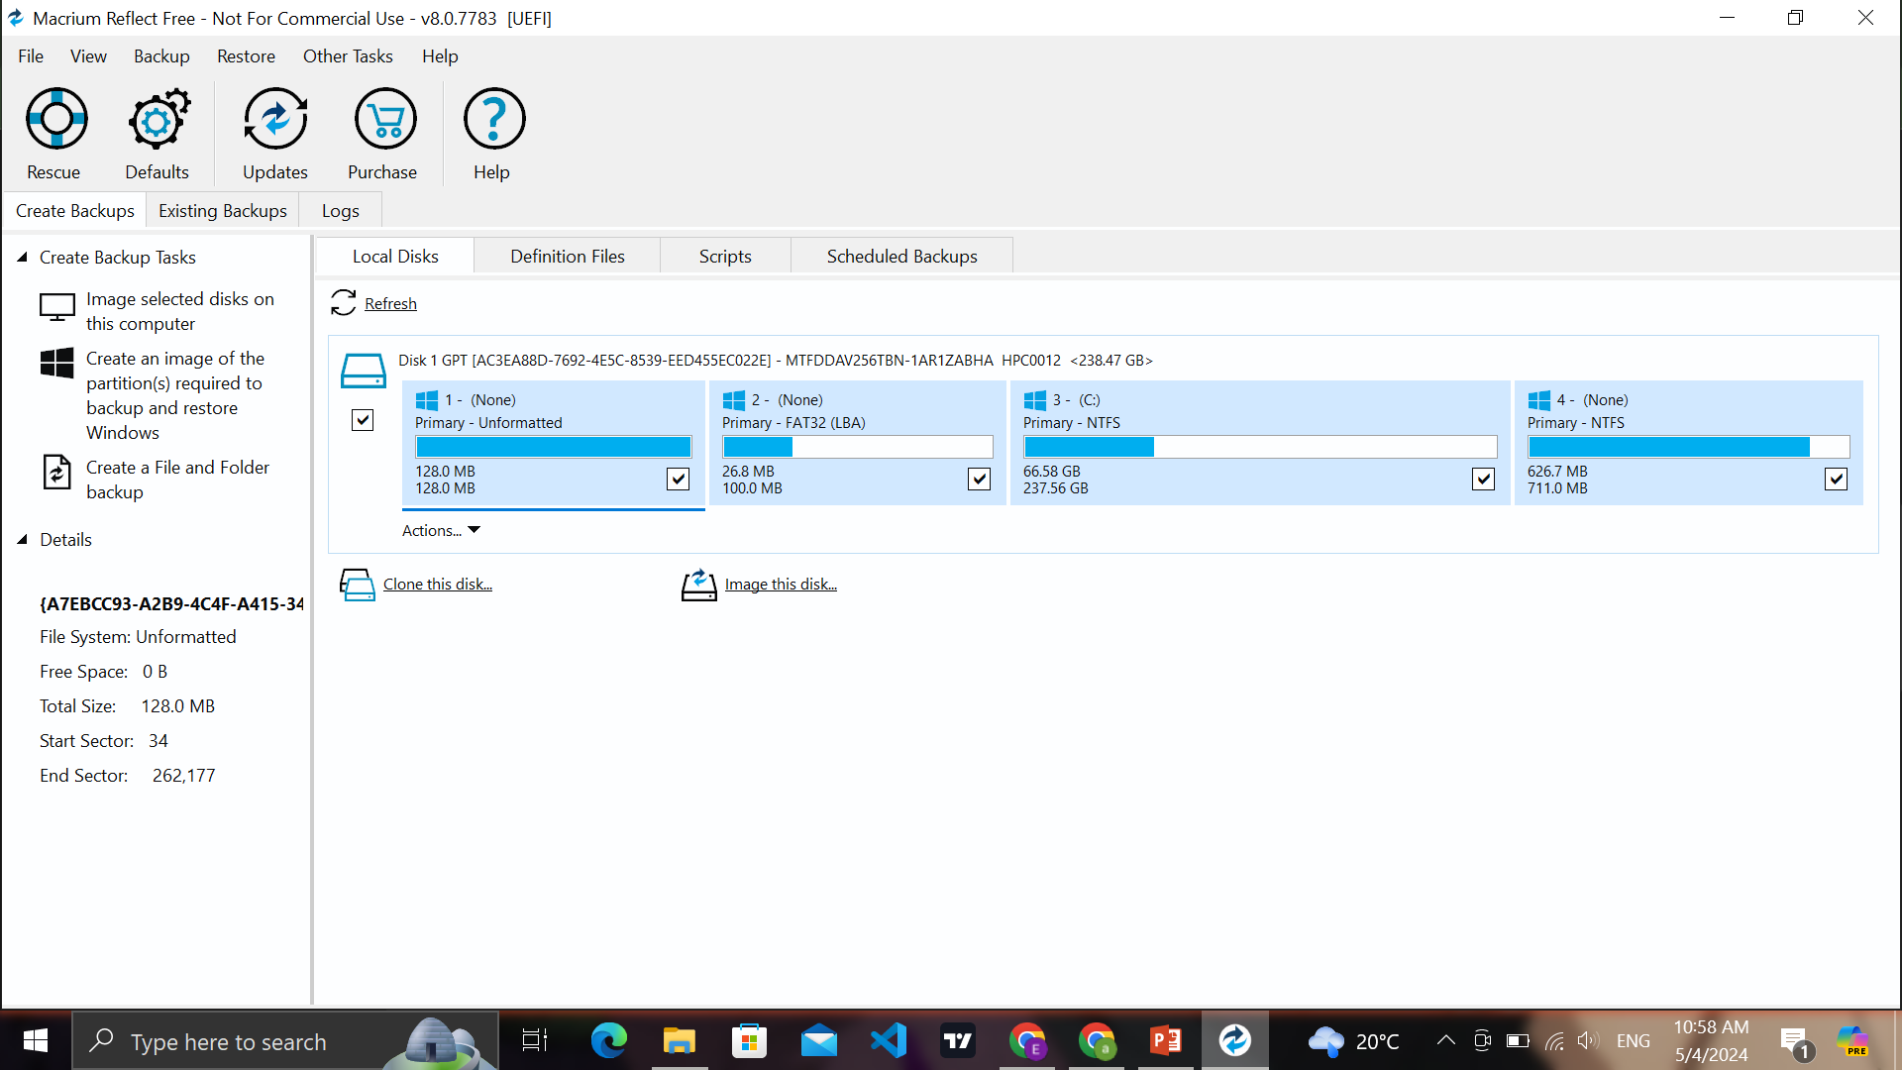
OPERATION
Select Source and Destination Disks: Choose the disk you want to clone (source disk) and the target disk where you want to clone it. Ensure the target disk has enough space to accommodate the clone.
Initiate the Clone Process: Click on the "Clone this disk..." option

Slide 4
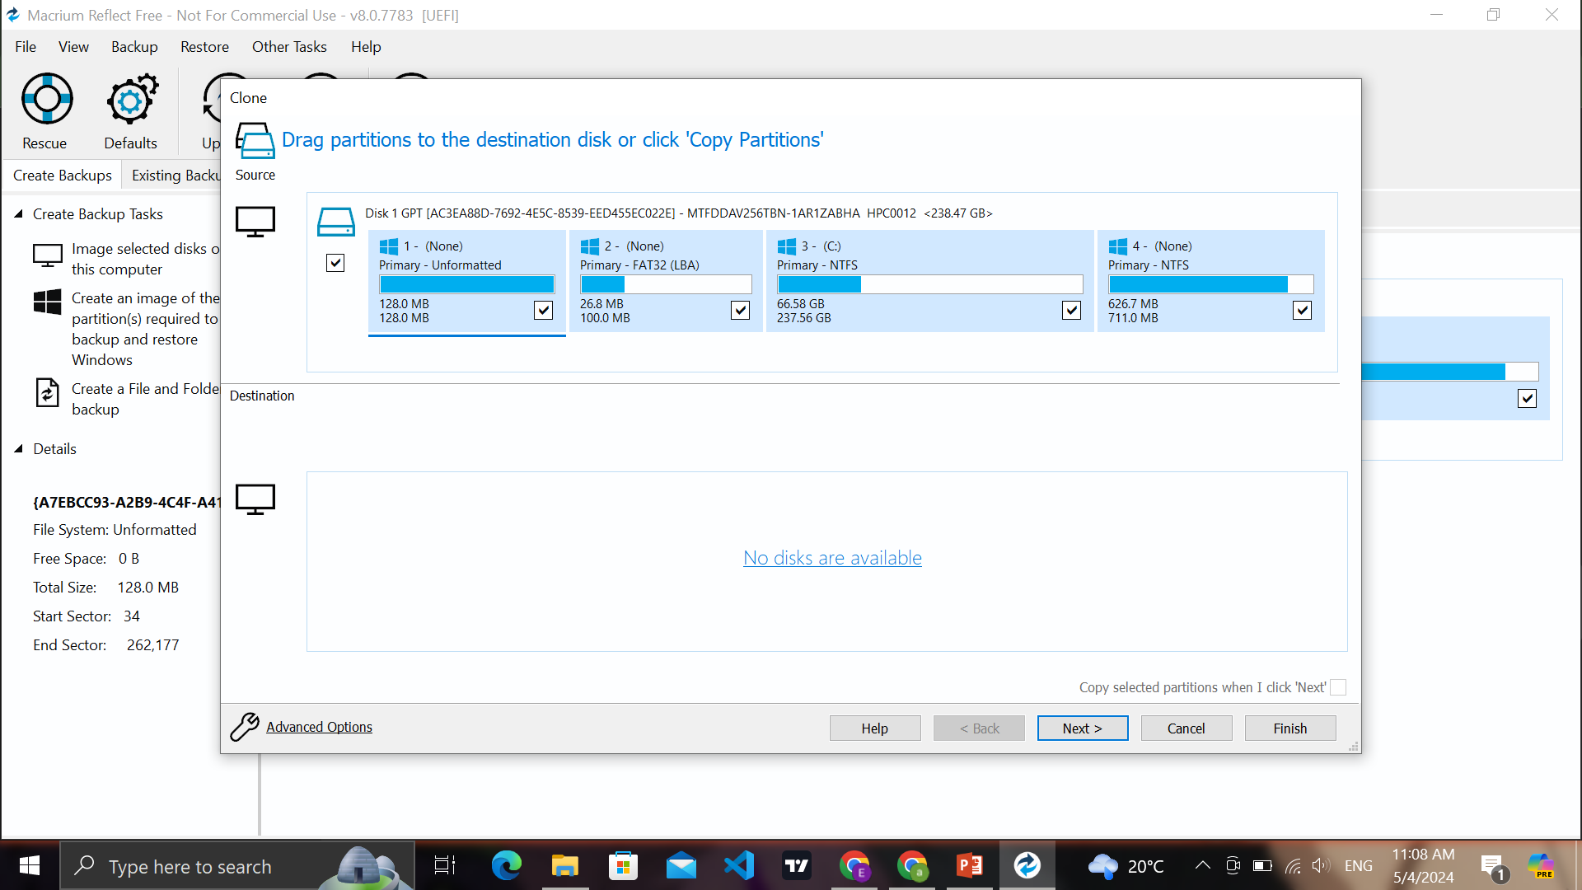
Customize Clone Options : Depending on your requirements, you can customize various aspects of the cloning process. This includes resizing partitions, excluding certain partitions from the clone, or opting for a sector-by-sector clone for maximum data integrity.
Start the Clone: Review your settings and initiate the cloning process. Macrium Reflect will begin copying the contents of the source disk to the destination disk. You can monitor the progress in real-time.

Slide 5
Monitor Progress: The cloning process may take some time, depending on factors such as disk size and system performance. Macrium Reflect provides a progress indicator to keep you informed throughout.
Completion and Verification: Once the cloning process is complete, Macrium Reflect will notify you. It's advisable to verify the cloned disk to ensure that all data has been transferred accurately and the disk is ready for use.

